Slide 1
Customer Survey Report
Calendared
May 9th 2019, 1:55 pm MDT

Slide 2
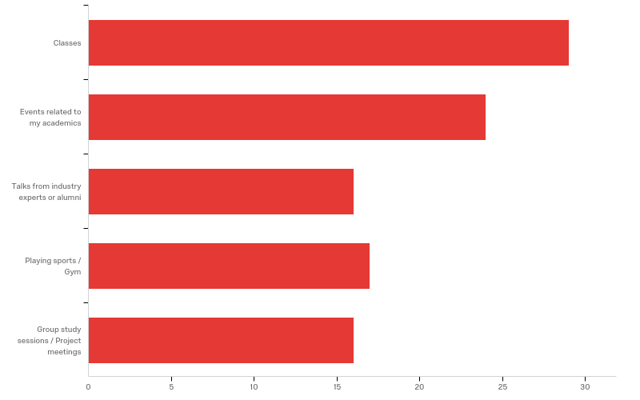
Q1 - What kind of events do you attend at the University? (Select all that apply)

Slide 3
Q1 - What kind of events do you attend at the University? (Select all that apply)
# | Answer | % | Count
1 | Classes | 28.43% | 29
2 | Events related to my academics | 23.53% | 24
3 | Talks from industry experts or alumni | 15.69% | 16
4 | Playing sports / Gym | 16.67% | 17
5 | Group study sessions / Project meetings | 15.69% | 16
 | Total | 100% | 102

Slide 4
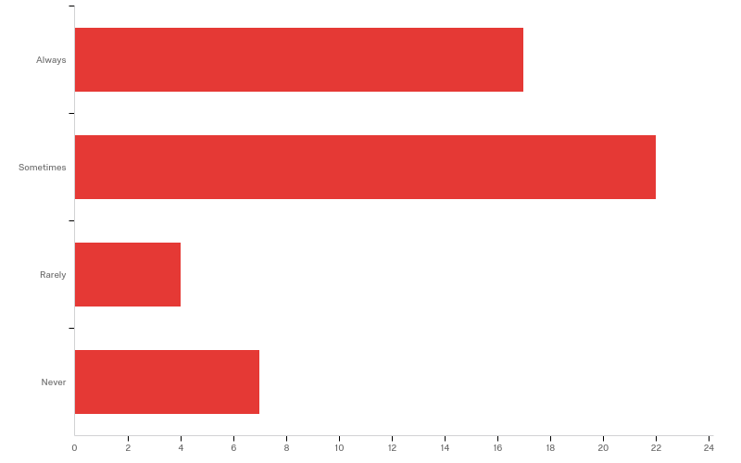
Q2 - Do you use your phone's calendar to keep track of these?

Slide 5
Q2 - Do you use your phone's calendar to keep track of these?
# | Field | Minimum | Maximum | Mean | Std Deviation | Variance | Count
1 | Do you use your phone's calendar to keep track of these? | 1.00 | 4.00 | 2.02 | 0.99 | 0.98 | 50

Slide 6
Q2 - Do you use your phone's calendar to keep track of these?
# | Answer | % | Count
1 | Always | 34.00% | 17
2 | Sometimes | 44.00% | 22
3 | Rarely | 8.00% | 4
4 | Never | 14.00% | 7
 | Total | 100% | 50

Slide 7
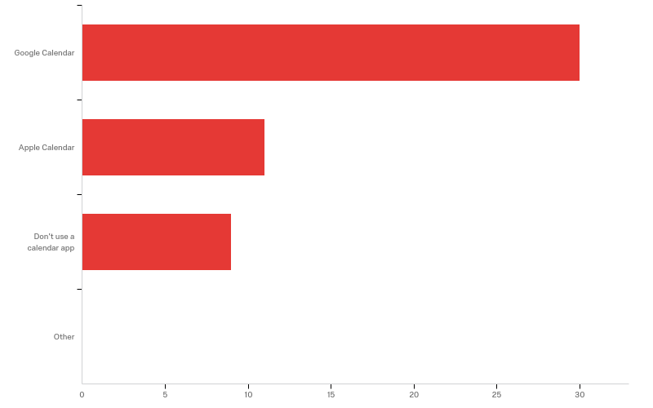
Q3 - Which calendar apps do you use on your phone?

Slide 8
Q3 - Which calendar apps do you use on your phone?
# | Field | Minimum | Maximum | Mean | Std Deviation | Variance | Count
1 | Which calendar apps do you use on your phone? - Selected Choice | 1.00 | 3.00 | 1.58 | 0.78 | 0.60 | 50

Slide 9
Q3 - Which calendar apps do you use on your phone?
# | Answer | % | Count
1 | Google Calendar | 60.00% | 30
2 | Apple Calendar | 22.00% | 11
3 | Don't use a calendar app | 18.00% | 9
4 | Other | 0.00% | 0
 | Total | 100% | 50

Slide 10
Q3 - Which calendar apps do you use on your phone?
Other - Text

Slide 11
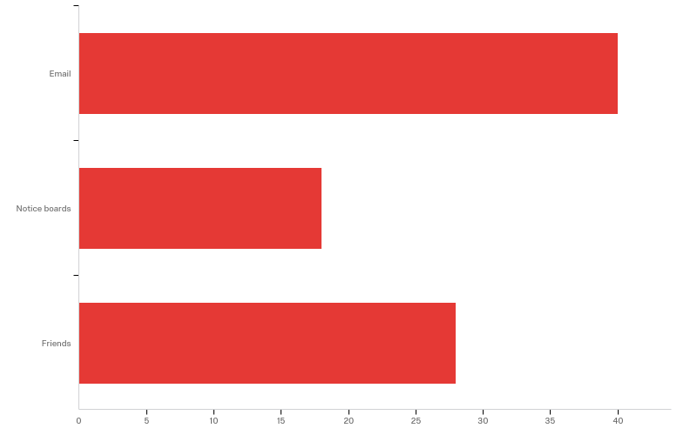
Q4 - Where do you get information about the events that you attend?

Slide 12
Q4 - Where do you get information about the events that you attend?
# | Answer | % | Count
1 | Email | 46.51% | 40
2 | Notice boards | 20.93% | 18
3 | Friends | 32.56% | 28
 | Total | 100% | 86

Slide 13
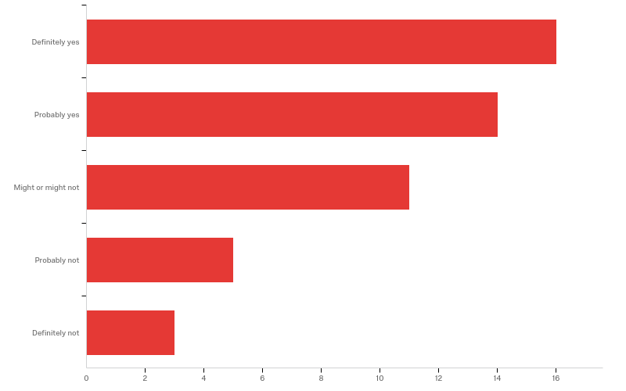
Q5 - Have you missed attending something just because you couldn't remember when it was?

Slide 14
Q5 - Have you missed attending something just because you couldn't remember when it was?
# | Field | Minimum | Maximum | Mean | Std Deviation | Variance | Count
1 | Have you missed attending something just because you couldn't remember when it was? | 1.00 | 5.00 | 2.29 | 1.20 | 1.43 | 49

Slide 15
Q5 - Have you missed attending something just because you couldn't remember when it was?
# | Answer | % | Count
1 | Definitely yes | 32.65% | 16
2 | Probably yes | 28.57% | 14
3 | Might or might not | 22.45% | 11
4 | Probably not | 10.20% | 5
5 | Definitely not | 6.12% | 3
 | Total | 100% | 49

Slide 16
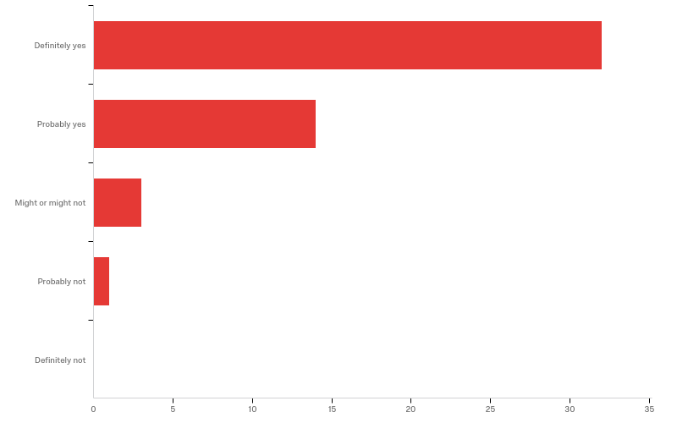
Q5 - Do you think being up-to-date about the event timings will help you in participating more?

Slide 17
Q5 - Do you think being up-to-date about the event timings will help you in participating more?
# | Field | Minimum | Maximum | Mean | Std Deviation | Variance | Count
1 | Do you think being up-to-date about the event timings will help you in participating more? | 1.00 | 4.00 | 1.46 | 0.70 | 0.49 | 50

Slide 18
Q5 - Do you think being up-to-date about the event timings will help you in participating more?
# | Answer | % | Count
1 | Definitely yes | 64.00% | 32
2 | Probably yes | 28.00% | 14
3 | Might or might not | 6.00% | 3
4 | Probably not | 2.00% | 1
5 | Definitely not | 0.00% | 0
 | Total | 100% | 50

